Slide 1
Real Guru
Timing the Real Estate Market

Slide 2
Target Audience
Problem
Real Estate Investors
REIT Managers
Developers
Real Estate Agents
First-Time Buyers
Move-Up Buyers
Passive Income Seekers
Determining the fair market value for rental real estate
Determining the timing to enter the market
Providing sound market advice to your clients
Property Appraisal

Slide 3
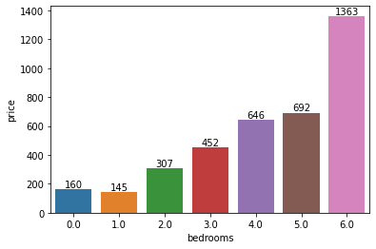
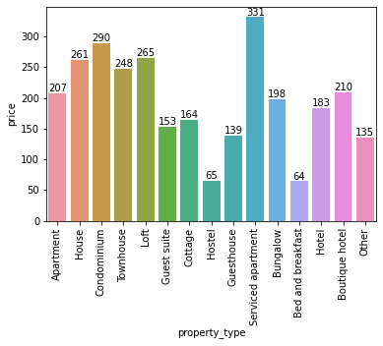
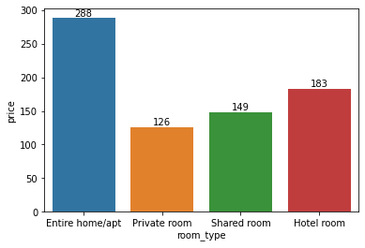
Overview of the Data
The data set contains features on various properties in the San Francisco area. The data describes the room type, property type, number of rooms, and the price charged per night.
Notes:
Average price and # of bedrooms are closely correlated. This is expected in real estate. More # of bedrooms tend to equates to higher prices.
Average price by each Room Types. Renting out an entire home or apartment will likely be the most expensive option. Its quite interesting to see that shared room is more expensive than a private room. Hotel room is the second most expensive option as it is expected to offer the most privacy and space after an entire home/apartment.
Average price expected by each property type. Based on the chart, Serviced apartment is the most expensive option. Hostels/Bed and breakfast types are least expensive. This aligns with the typical real estate/hospitality market.

Slide 4
Chosen Model
Recommendations:
Based on the model scores, I've decided to choose KNeighbors as my chosen regressor model. Across the three models, KNeighbors model yielded the lowest MAE score as well as the lowest RMSE score. The reason I prioritized MAE and RMSE is because this is a price prediction and the lower the difference between prediction than the actual target the better. In the case of the chosen KNeighbors model, the MAE score was less than 100. The RMSE score which determines how closely fit the predictions are to the regression line was also the lowest in the chosen model.
Strengths:
Simple
Adaptable to change
KNN works well with small number of input variables
Weakness:
It’s strength is also its weakness. As the numbers of variables grow K-NN algorithm struggles to predict the output of new data point.
Sensitive to outliers
Prone to imbalance data

Slide 5
Appendix
Metrics for evaluating the Model:
MAE: Mean absolute error measures the average of the absolute values of all of the errors our model makes.
MSE: Mean squared error is similar to mean absolute error, but it penalizes large errors more.
RMSE: Root Mean Square Error (RMSE) is the standard deviation of the residuals (prediction errors). Residuals are a measure of how far from the regression line data points are. (Concentration) Like the previous two metrics, a lower RMSE is better.
R^2: This score can be interpreted as saying that our model can account for about XX% of the variation in target data using the features in training data. (Not really a high priority measurement in this use case)

